Slide 1
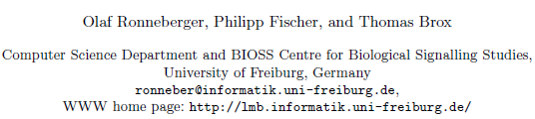
U-Net: Convolutional Networks for Biomedical Image Segmentation
Olaf Ronneberger, Philipp Fischer, and Thomas Brox
International Conference On Medical Image Computing & Computer Assisted Intervention (MICCAI), 2015
Student: 許書維
Professor: 連震杰 教授
2025/05/08

Slide 2
0. Scraping Project Road Map: From 2019/01/B to 2019/03/E
2019
01
02
03
1. Solve PPI unstable problem
1. Solve PPI problem
-Note:
Black: Done
Red: On-going
Light Blue: Future work
1.1) 01/B~01/B: Solve PPI unstable problem(Flood filled).
2. Deep Learning-Based Segmentation
2. Deep Learning-Based Segmentation for Scraping Improvement
2.1) 01/B~01/M: Paper1 C168_Color Name: Learning Color Name from Real-World Images
2.2) 01/M~01/E: Paper2 C744_Adaptive Color Attributes for Real-Time Visual Tracking_CVPR2014
2.3) 02/B~02/E: Paper3 Deep Learning U-Net Segmentation(實作)
2.4) 03/B~05/E: Scraping Segmentation using Deep Learning U-Net Segmentation
3. CASE_Paper
3. Publish Paper
3.1) 2/M~2/E: CASE_Evaluation of Scraping Workpiece Quality with Cloud Computing.
- Publish:
D_Conference 1: Scraping
D_Conference 2: eCv Embedded +Qr Code
-Paper:
Paper1: Learning Color Name from Real-World Images_CVPR2007
Paper2: Adaptive Color Attributes for Real-Time Visual Tracking_CVPR2014
Paper3: Deep learning: Deep Learning U-Net Segmentation
- Conference:
Domestic: CVGIP (2019/07/01), TAAI(2019/09/01) International: CASE(2019/03/01), AVSS(2019/09/01), ACCV()….
- Journals:
IJCV (2020/03/31)

Slide 3
0. Scraping Project Road Map: From 2019/04/B to 2019/06/E
2019
04
05
06
-Note:
Black: Done
Red: On-going
Light Blue: Future work
2. Deep Learning-Based Segmentation
2. Deep Learning-Based Segmentation for Scraping Improvement
2.4) 03/B~05/E: Scraping Segmentation using Deep Learning U-Net Segmentation
2.5) 04/B~05/B: DB1 and DB2 hand labeling
4. Publish Paper
4. Publish Scraping Paper
3.2) 3/B~4/M: Prepare related works (deep learning u-Net /color name/ laser-based measurement …)
3.3) 4/M~5/M: Write paper D_Conferece 1 Scraping (Deep Learning+ Whole system)
3.4) 5/M~6/M: Write paper D_Conferece 2 eCv QRcode
3.5) 6/M~12/E: Improve deep learning I_Conferece 3 Scraping
3.6) ~2020 6/E: Journal. 1 Scraping
5. APP Solution
5. APP Solution
4.1) 4/M~4/E: Solve the yellow square detection low success rate
4.2) 4/M~4/E: App 傳輸整張影像
6. Build Database and Create PDF Report
6. Build Database and Create PDF Report
4.1) 04/B~04/M: Create PDF Report
4.2) 04/B~04/M: New function of Report on APP
4.3) 04/B~04/M: 第一個版本(HSV)交接
4.4) 04/M~04/E: Build the Database (NoSQL / MySQL)

Slide 4
0. Outline
1. Introduction
1.1 Motivation ,Objective and Global Framework
1.2 Related work
2. System Setup ,Function and Specification
2.1 Hardware Specification
2.2 Function Specification
3. Image Segmentation Using U-Net
3.1 Framework of Training Process
3.2 Framework of Test Process
4. Experimenta1 Results
4.1 Data Collection and Metric
4.2 Experimental Results
5. Conclusion
6. References
7. Appendix
Q&A:

Slide 5
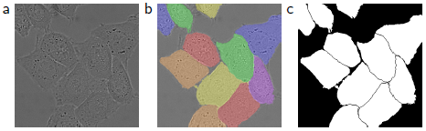
1.1 Motivation ,Objective and Global Framework
Motivation:
Deep convolutional networks have outperformed the state of the art in many visual recognition tasks. So would like to use deep learning method to replace traditional image segmentation.
Objective:
1. The resulting network is applicable to various biomedical segmentation problems. Results for cell segmentation in light microscopy images.
2. Thousands of training images are usually beyond reach in biomedical tasks, so works with very few training images and yields more precise segmentations.
(In paper train dataset just only have 30 images.)
Optical edge detection
Binary mask
Region segmentation
Fig.3 HeLa cells on glass recorded with DIC (differential interference contrast) microscopy. (a) raw image. (b) overlay with ground truth segmentation. Different colors indicate different instances of the HeLa cells. (c) generated segmentation mask (white: foreground, black: background).

Slide 6
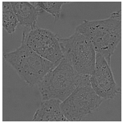
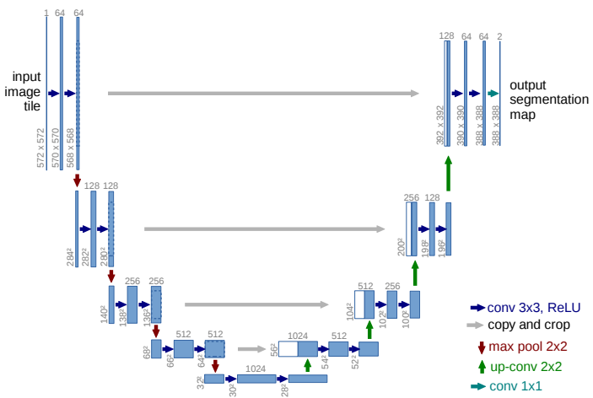
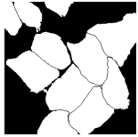
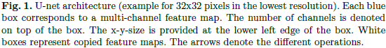
1.1 Motivation ,Objective and Global Framework
Global Framework:
1. The network is trained end-to-end from very few images.
2. The U-Shaped architecture consists of
1) a contracting path to capture context and
2) a symmetric expanding path that enables precise localization.
- The expansive path is more or less symmetric to the contracting path, and yields a u-shaped architecture.
Ford: like Auto-encoder (decode & encode)
1) Contracting path
(Encoder)
2) Expanding path
(Decoder)

Slide 7
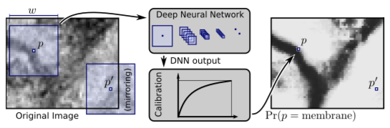
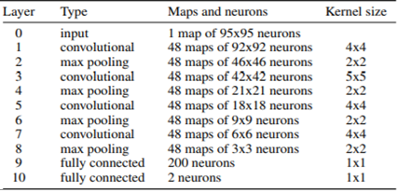
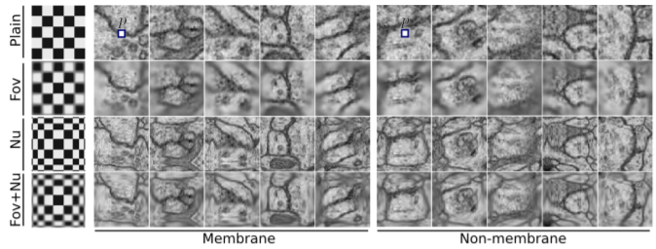
1.2 Related work (1/2)
1. Ciresan et al.[1]: is based on a Deep Neural Network (DNN) used as a pixel classifier.
- Trained a network in a sliding-window setup to predict the class label of each pixel by providing
a local region (patch) around that pixel as input.(fix size)
(training data in terms of patches is much larger than the number of training images.)
2. For each pixel consider two possible classes, membrane and non-membrane.
- The DNN classifier computes the probability of a pixel p being of the former class.
1 to 4 stages of convolutional and max-pooling layers: feature extraction
30 images 512x512 pixels
Final Layer: fully connected layers for classification
W=95 pixels
One stage
Create 50,000 patches

Slide 8
1.2 Related work (2/2)
DNN Classification two drawbacks:
1. Slow: Network must be run separately for each patch, and there is a lot of redundancy due to overlapping patches.
2. Trade-off between localization accuracy and the use of context:
- Larger patches: require more max-pooling layers that reduce the localization accuracy.
- Small patches: allow the network to see only little context.
(Good localization and the use of context are possible at the same time.)
3. Input image size is fixed:
- The last two layers is fully connection network.
512
95
95
512

Slide 9
1.3 Contribution
Q1: Biomedical segmentation problems only few training dataset
A1.1: Do data augmentation.
A1.2: Initialization weights.
Q2: Form relative work sliding window process to slow and hard decision window size
A2: Input whole region.
Q3: Different frequency of pixels from a certain class in the training data set
A3: Add weight to the loss function for each pixel.

Slide 10
2.1 Hardware Specification

Slide 11
2.2 Function Specification

Slide 12
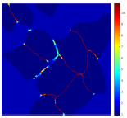
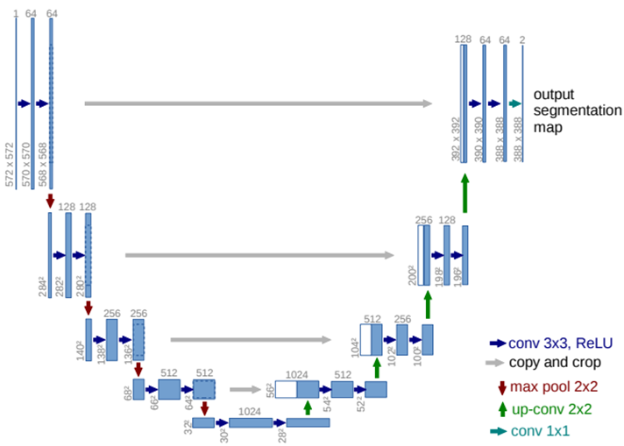
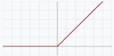

3.1 Framework of Training Process (1/5) ??
Total the network has 23 convolutional layers.
U-Net Architecture: is Fully Convolutional Network (FCN) and consists of a 1) contracting path and 2. expanding path.
Training: 2 O/P maps:
- Map1): Segmentation map - Label Fogd/bkgd 1/0
- Map2): Boundary 1/0 btw cell and cell or cell and bkgd
Contracting path
(Encoder)
2) Expansive path
(Decoder)
(1) -3x3 Convolution
-(Unpadded convolutions)
- Activation function: ReLU
-Stride: 1
(5) 1x1x64 fully convolution (FCN) and 388x388 filters: 64 component feature vector to the desired number of classes K=2.
(4) Concatenate– Crop (dash-region) and then Copy/concatenate features map form contracting path: 從Contracting path 中 1 stage最後一個convolution中feature map複製到Expansive path對應的feature map相同大小。
572-2=570
64+64(form first block)=128
388
Local feature
388
Input 572x572 grayvalue image
64 of 392x392 feature maps
64c
392x392
Test O/P: (388x388)x2 heat maps
Due to the unpadded convolutions, the output image is smaller than the input. (572*572->388*388)
196*2=392
(2) Max pooling
-Window size = 2x2
-Stride = 2
Filter:(3x3x64)x 128個
64
64
128 of 200x200 feature maps
568/2=284
(3) Up-Convolution
- (Unpadded convolutions)
- Window size = 2x2
- Stride = 2
128
128
256 of 104x104 feature maps
Filter:(3x3x1024)x 512個
256
512 of 56x56: cropped feature maps from 64 to 56
256
??reduce to Half or channel number
concatenate
Global feature
512
1024
Filter:(2?x2?x1024)x 512個, s=2
Drop-out
Code

Slide 13
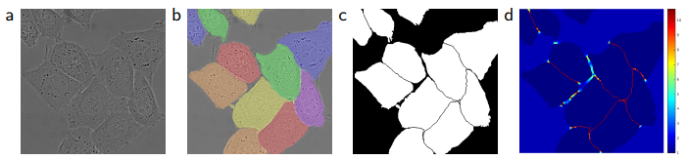
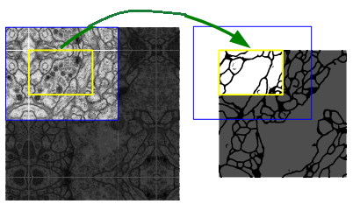
3.1 Framework of Training Process (2/5)
Note: It’s important to select the input tile size such that all 2x2 max-pooling operations are applied to a layer with an even x- and y-size.
1. Training Data Preprocessing
1) Training data and labeling:
(1) Images (I_{n}: 512x512): W*H Grayscale image
- Input: W*H=512*512 pixels
- N: number of training images I (=30)
(2) Segmentation Labels (L_{n}): - Pixel wise Label 1/0: A class label is supposed to be assigned to each pixel.
2) Create extended image (I’_{n}: 880x880 pixels): I_{n} border region extrapolated by mirroring (I_{n}’): To predict the pixels in the border region of the image.
Ford: 512 x 512 -> 880 x 880 (by 512+184x2=880)
- 先對單一邊進行鏡射，接著再對另一邊做鏡射(此時包含剛剛鏡射的結果)
3) Data Augmentation and patch image I_{n}’’ (572x572): Crop the patches from image I_{n}’ with the size of 572 x 572 pixels. (Shift ,Rotation and Gray value variations).
- Estimate Size: Only estimate inner side 388 x 388 pixels.
(Background: “0” /foreground: “1”)
Q: Input Data only Grayscale image?
512
512
880
512
880
880
880
572
572
388
184
F:
In order to have the same input and output crop image size 388x388 pixels, so the input crop image size needs to be 572x572.
Original image size is 512x512 pixels (red dash rectangle). To reach above condition, therefore, it needs to extend to 880x880.
572
388
572
388
512
388
880
512
- Prediction of the segmentation in the yellow area, requires image data within the blue area as input.
- Missing input data is extrapolated by mirroring
patch I_{n}’’(x,y)

Slide 14
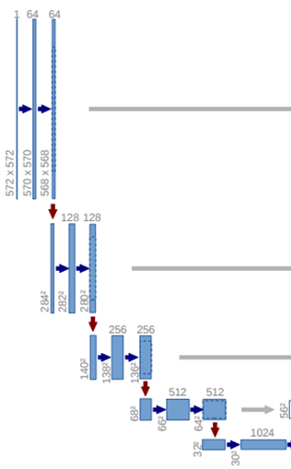
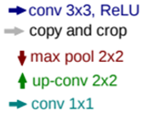
3.1 Framework of Training Process (3/5)
Patch I_{n}’’
2. Region Segmentation using U-Net (10 hours on a NVidia Titan GPU/6 GB)
2.1 Multi-Level Feature Extraction on Contracting Path (Encoder):
- Total 4 stages on Contraction Path
> Each Stage: consist of 2 convolution and 1 max pooling. > The first few stages: feature map mainly describe the local feature.
> The last few stages: feature map mainly describe the global feature.
1) 3x3 Convolution for feature extraction
- Para:
> Window size: 3x3
> Stride: 1
- Activation function: ReLU
(Drop-out layers at the end of the contracting path perform further
Implicit data augmentation.)
- Unpadded: 每做完一次 H 和 W 會減少2 pixels, 所以造成最後output的
image size 小於 input image size.
2) 2x2 Max pooling for downsampling
- Para.:
> Window size: 2x2
> Stride: 2
- Decide window size: Too many max pooling or max pooling window size too large will effect
localization accuracy.
- At each downsampling step it will double the number of feature channels.
number of channels at each stage: 64->128->256->1024
(F: A few local features create multiple global features )
Ex:
local feature: Point. Line. Corner…
Stage1-1
Stage1-2
Stage1-3
Stage1-4
Drop-out
Synmatic global feature
: Shape
global feature
…
local feature

Slide 15
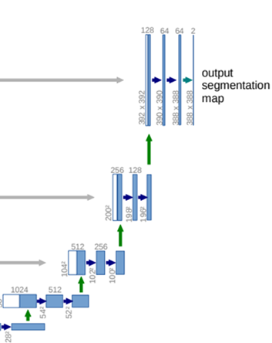
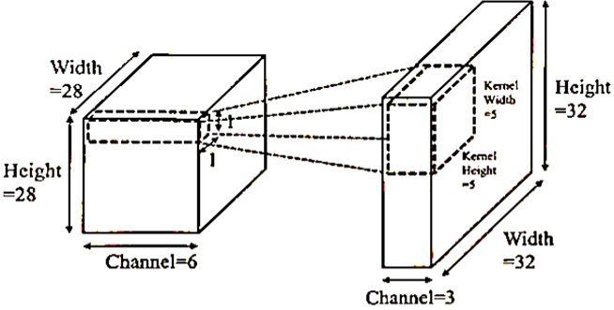
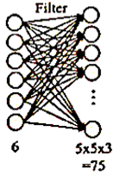
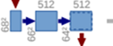
3.1 Framework of Training Process (4/5)
2. Region segmentation using U-Net
2.2 Multi-Level Concatnation on Expansive path (Decoder): 從低解析度的feature map 還原回整張影像
- Total 4 stages on Expansive path
> Each Stage: Consist of 2 convolution, up-convolution, and Concatenate.
1) Up-sampling convolution 2x2: Restore image
- Para.:
> Window size: 2 x 2
> Stride: 2
- Activation function: ReLU
- Have a large number of feature channels, which allow the network
to propagate context information to higher resolution layers.
2) Concatenate (Copy and Crop): Increase the resolution of the output detail
- In order to localize, high resolution features from the contracting path are combined with the upsampled output.
- Can learn to assemble a more precise output based on this information.
- Concatenate size: Take the same size feature map as the center, rounding off the surrounding pixels.
3) 3x3 Convolution: Feature merge
- Para:
> Window size: 3x3
> Stride: 1
- Activation function: ReLU
- Unpadded: 每做完一次 H 和 W 會減少2 pixels
Stage2-1
Stage2-2
Stage2-3
Contracting Path
Stage2-4

Slide 16
3.1 Framework of Training Process (4/5)
2. Region segmentation using U-Net
2.3 Classification on Expansive path:
Classification (1x1 convolution ) (stage 2-1): 64 channel feature merge
to decide the class score
- 64 component feature vector to the desired number of classes K=2.
(1) Background / Foreground: 0/1
(2) Background / touching cells: 0/1
2) pixel-wise soft-max: Calculate the probability of each pixel
corresponding to k class.
Stage2-1
388
388
x 2 (Num. of class K)
64
Stage2-2
Because of segmentation is doing by probability 0~1, so use exponential to make it separate widely
- Pare.:
> a_{k}(x) denotes the activation in feature channel k at the pixel position x.
> K: the number of classes.
> p_{k}(x) is the approximated maximum-function.
i.e. p_{k}(x)≈1 for the k that has the maximum activation a_{k}(x) and p_{k}(x)≈ 0 for all other k.
Stage2-3
Stage2-4
Why input patch size is 572 x 572 pixels, but output segmentation map size only 388 x 388?
A: Because the architecture of U-net totally have 23 convolution.
- Contracting path: (2+2) + 2*(2+2) + 2*2*(2+2) + 2*2*2*(2+2) + 2*2*2*2*(2+2)= 124
- Expansive path: 2*2*2*(2+2) + 2*2*(2+2) + 2*(2+2)=60
Total loss (124+60) 184 pixels form input patch.

Slide 17
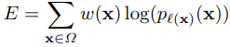
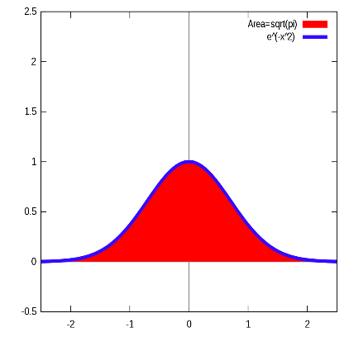
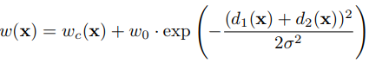
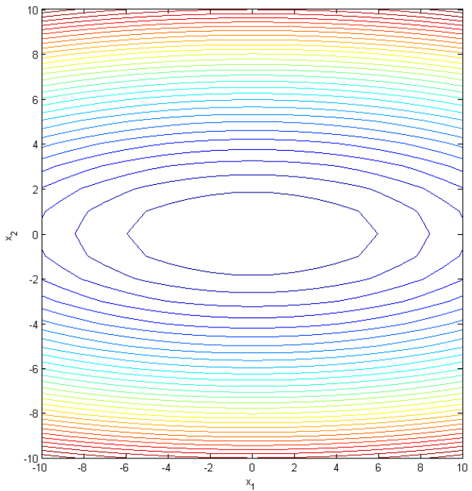
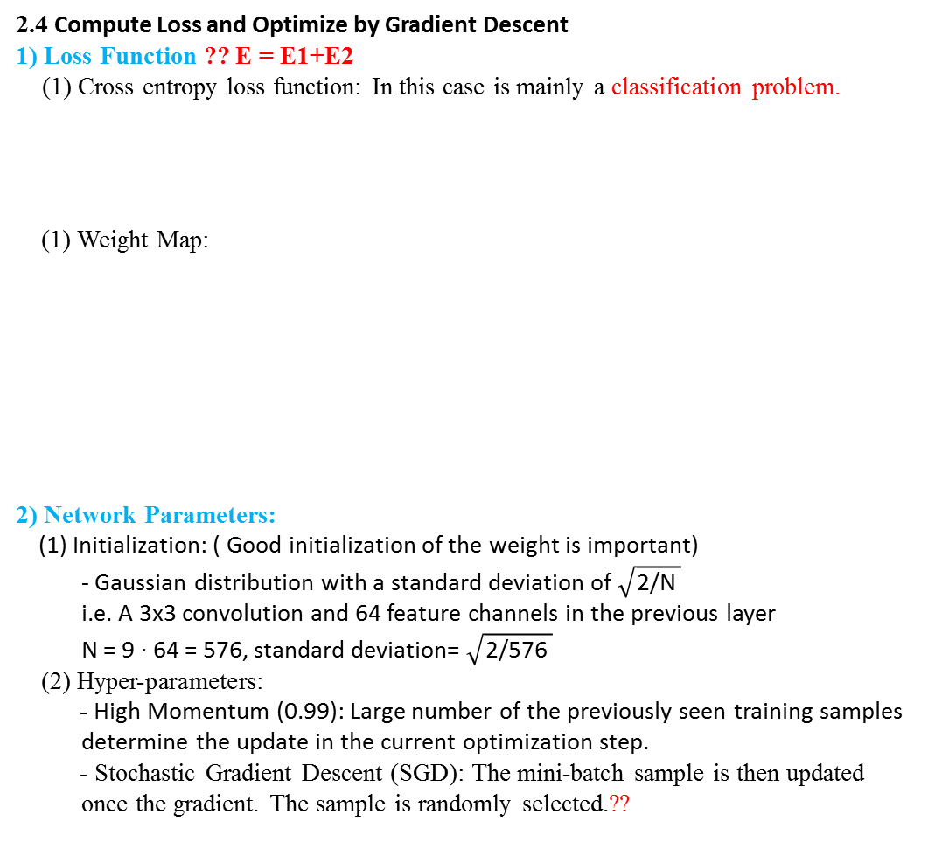
3.1 Framework of Training Process (5/5)
Para:
> l : {1, . . . , K} is the true label of each pixel
> w : is a weight map that we introduced to give some pixels more importance in the training.
> w_{c} : is the weight map to balance the class frequencies.
> d₁ : denotes the distance to the border of the nearest cell.
> d₂ : the distance to the border of the second nearest cell.
2. Region segmentation using U-Net ??
2.4 Compute Loss and Optimize by Gradient Descent
1) Loss Function ?? E = E1+E2
(1) Cross entropy loss function: In this case is mainly a classification problem.
(1) Weight Map:
2) Network Parameters:
(1) Initialization: ( Good initialization of the weight is important)
- Gaussian distribution with a standard deviation of $\sqrt{\text{2/}\text{N} }$
i.e. A 3x3 convolution and 64 feature channels in the previous layer
N = 9 · 64 = 576, standard deviation= $\sqrt{\text{2/576} }$
(2) Hyper-parameters:
- High Momentum (0.99): Large number of the previously seen training samples determine the update in the current optimization step.
- Stochastic Gradient Descent (SGD): The mini-batch sample is then updated once the gradient. The sample is randomly selected.??
- The cross entropy then penalizes at each position x(x,y) the deviation of P_{l} (x)(X)
Priori prob.
Map with a pixel-wise loss weight to force the
network to learn the border pixels.
(Same as Retina-net loss function α)
- Pre-compute the weight map for each ground truth segmentation.
- Force the network to learn the small separation borders that between touching cells.
(越是接近邊緣，對應的weight map 也就愈高)
Average two distance
w₀= 10
Ford: Using distance transform to be weight map.
σ= 5
因為cell邊緣的pixels相對整張影像少，所以為了讓訓練過程中能平衡，所以加入weight的概念。
More channel feature map have smaller standard deviation

Slide 18
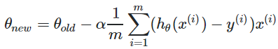
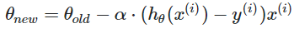
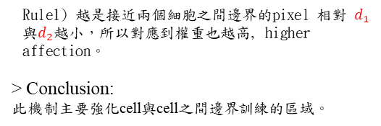
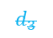
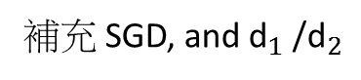
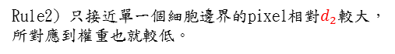
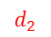
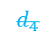
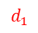
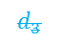
3.1 Framework of Training Process (5/5)
補充 SGD, and ${\text{d}}_{1}$ /${\text{d}}_{2}$
Weight Map
Higher weight
$$d_{1}$$
(x₂, y₂)
> Define:
$$d_{2}$$
$$d_{4}$$
$$d_{3}$$
w₀= 10
σ= 5
> Physical meaning:
Rule2) 只接近單一個細胞邊界的pixel相對$d_{2}$較大，所對應到權重也就較低。
$$d_{1}$$
Rule1) 越是接近兩個細胞之間邊界的pixel 相對 $d_{1}$與$d_{2}$越小，所以對應到權重也越高, higher affection。
> Conclusion:
此機制主要強化cell與cell之間邊界訓練的區域。
$$d_{2}$$
(x₁, y₁)
$$d_{3}$$
Gradient Decent (GD) Vs. stochastic gradient decent (SGD)
Suppose we have 1 billion data.
GD: In order to update the parameters once, we need to have the (exact) gradient. This requires to sum up these 1 billion data points to perform 1 update. There is no concept of "epoch ??" or "batch" in classical gradient decent.
Gradient Decent (GD), update the parameter by
(takes long time)
Wayne : 所有資料平均，較慢
SGD: do NOT need to have exact gradient to reduce the cost in a given iteration. it as trying to get an approximated gradient instead of exact gradient. The approximation is coming from one data point (or several data points called mini batch). then the concepts of batch and epoch come.we get rid of the sum and 1/m constant, but get the gradient for current data point x^{(i)},y^{(i)}.’
Stochastic Gradient Decent (SGD), update the parameter by
(update the parameters much faster)
Wayne : 單一筆資料或批次，較快
do not need to have 1 billion iterations/updates, but much less iterations/updates, say 1 million, and you will have "good enough" model to use.
http://ruder.io/optimizing-gradient-descent/index.html#shufflingandcurriculumlearning

Slide 19
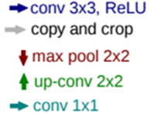
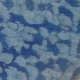
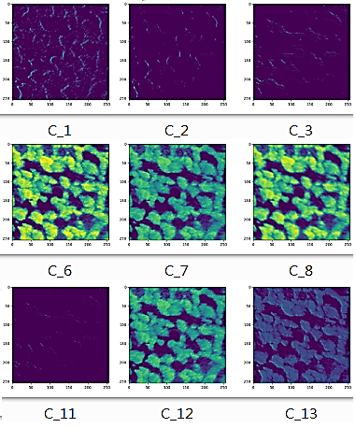
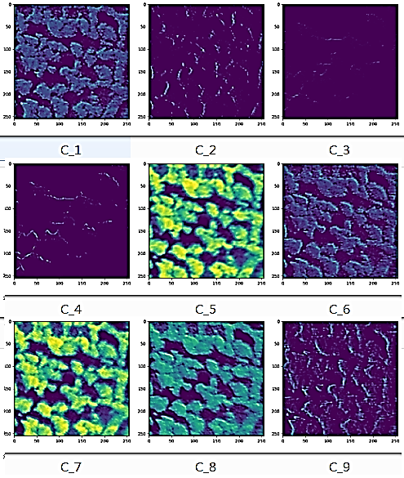
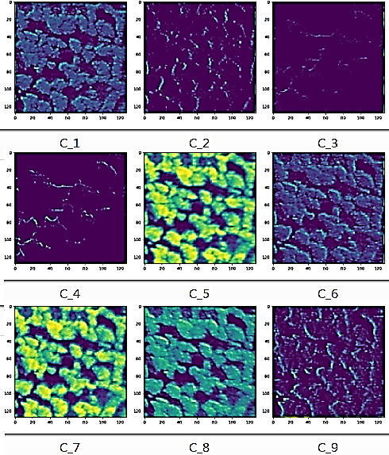
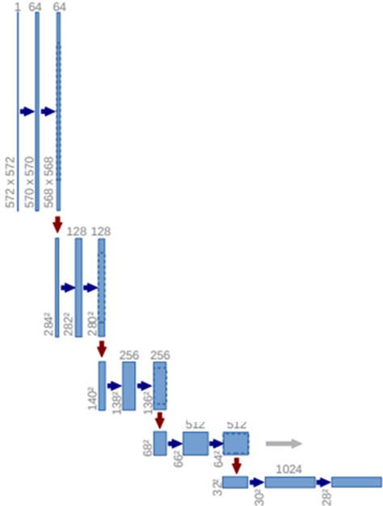
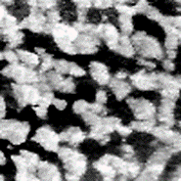
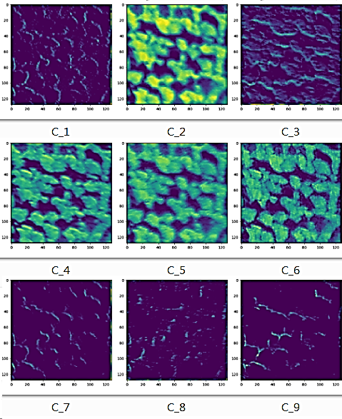
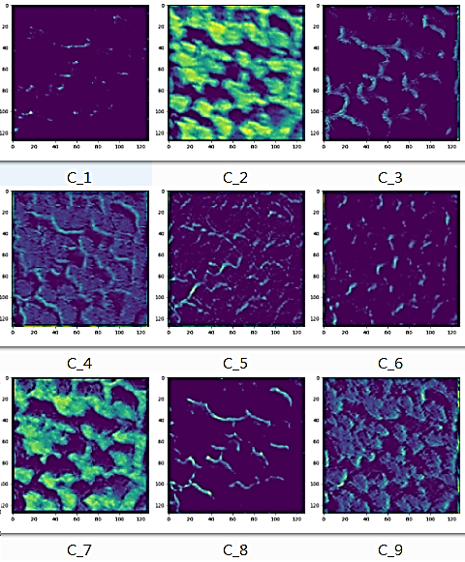
3.2 Feature Map: Contracting Path (1/3)
Feature Extraction on Contracting Path
RGB2Gray
Stage1-1:
Conv
Conv
Max pooling
Stage1-2:
Conv
Conv
Max pooling

Slide 20
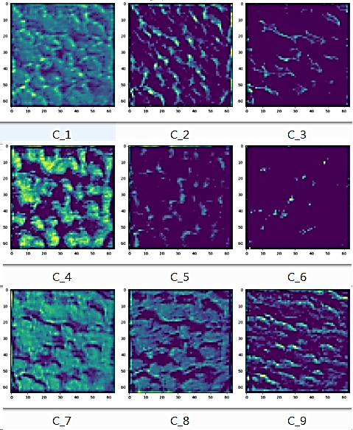
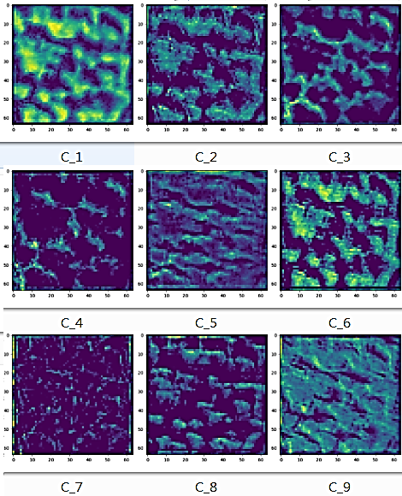
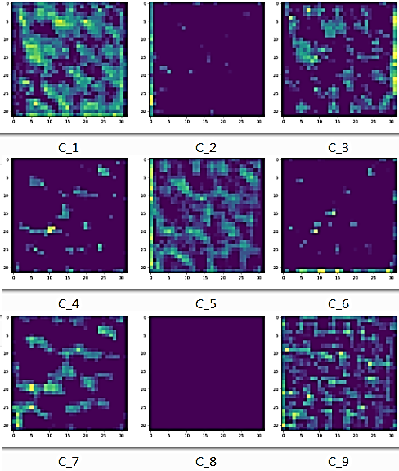
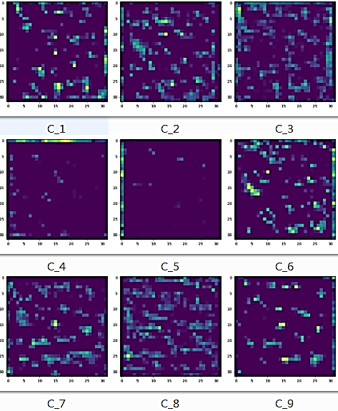
3.2 Feature Map: Contracting Path (2/3)
Feature Extraction on Contracting Path
Stage1-3:
Conv
Conv
Max pooling
Stage1-4:
Conv
Conv
Max pooling

Slide 21
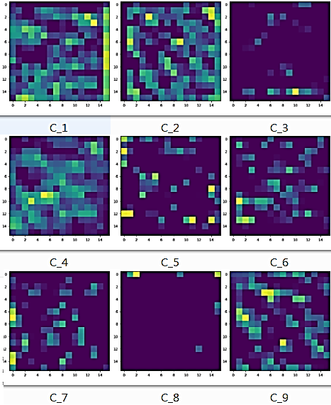
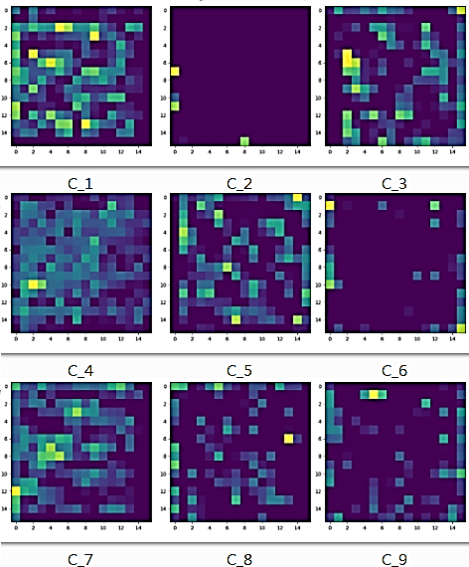
3.2 Feature Map: Contracting Path (3/3)
Feature Extraction on Contracting Path
Conv
Conv

Slide 22







3.2 Feature Map: Expansive path (2/2)
Feature merge on Expansive path
Stage2-3
Stage2-4
Up-conv
Conv
Conv
Stage2-3:
Stage2-4:

Slide 23








3.2 Feature Map: Expansive path (2/2)
Feature merge on Expansive path
Segmentation map
Stage2-1:
Stage2-2:
Up-conv
Conv
Conv

Slide 24





4.1 Data Collection and Metric
Data Collection:
- Serial section transmission electron microscopy of the Drosophila first instar larva ventral nerve cord (VNC).
Resolution (pixels) | Number of image
512 x 512 | 30
Data Augmentation: Essential to teach the network the desired invariance and robustness properties, when only few training samples are available.
Shift, Rotation and Gray value variations for training image(microscopical images).
388
388
1. Shift
512
388
388
2. Rotation
512
(7 rotated versions)
- Generate smooth deformations using random displacement vectors on a coarse 3 by 3 filter.
- The displacements are sampled from a Gaussian distribution with 10 standard deviation.
3. Gray value variations
Drop-out layers at the end of the contracting path perform further implicit data augmentation.
Data 1 -> Dropout -> Result 1
Data 1+Noise -> No Dropout -> Result 2
=
(Data Augmentation)
Reference: DROPOUT AS DATA AUGMENTATION

Slide 25

4.2 Experiments and Result (1/2)
U-Net better than the sliding-window convolutional network result by Ciresan et al. [1], whose best submission had a warping error of 0.000420 and a rand error of 0.0504.
In terms of rand error the only better performing algorithms on this data set use highly data set specific post-processing methods applied to the probability map of Ciresan et al. [1].

Slide 26


4.2 Experiments and Result (2/2)
Two different dataset

Slide 27
5. Conclusion
1. The u-net architecture achieves very good performance on very different biomedical segmentation applications.
2. Thanks to data augmentation with elastic deformations: It only needs very few annotated images and has a very reasonable training time of only 10 hours on a NVidia Titan GPU (6 GB).
3. The u-net architecture can be applied easily to many more tasks.

Slide 28
6. References (1/2)
[1] Ciresan, D.C., Gambardella, L.M., Giusti, A., Schmidhuber, J.: Deep neural networks segment neuronal membranes in electron microscopy images. In: NIPS. pp. 2852–2860 (2012)
[2] Dosovitskiy, A., Springenberg, J.T., Riedmiller, M., Brox, T.: Discriminative unsupervised feature learning with convolutional neural networks. In: NIPS (2014)
[3] Girshick, R., Donahue, J., Darrell, T., Malik, J.: Rich feature hierarchies for accurate object detection and semantic segmentation. In: Proceedings of the IEEE Conference on Computer Vision and Pattern Recognition (CVPR) (2014)
[4] Hariharan, B., Arbelez, P., Girshick, R., Malik, J.: Hypercolumns for object segmentation and fine-grained localization (2014), arXiv:1411.5752 [cs.CV]
[5] He, K., Zhang, X., Ren, S., Sun, J.: Delving deep into rectifiers: Surpassing humanlevel performance on imagenet classification (2015), arXiv:1502.01852 [cs.CV]
[6] Jia, Y., Shelhamer, E., Donahue, J., Karayev, S., Long, J., Girshick, R., Guadarrama, S., Darrell, T.: Caffe: Convolutional architecture for fast feature embedding (2014), arXiv:1408.5093 [cs.CV]
[7] Krizhevsky, A., Sutskever, I., Hinton, G.E.: Imagenet classification with deep convolutional neural networks. In: NIPS. pp. 1106–1114 (2012)

Slide 29
6. References (2/2)
[8] LeCun, Y., Boser, B., Denker, J.S., Henderson, D., Howard, R.E., Hubbard, W., Jackel, L.D.: Backpropagation applied to handwritten zip code recognition. Neural Computation 1(4), 541–551 (1989)
[9] Long, J., Shelhamer, E., Darrell, T.: Fully convolutional networks for semantic segmentation (2014), arXiv:1411.4038 [cs.CV]
[10] Maska, M., (...), de Solorzano, C.O.: A benchmark for comparison of cell tracking algorithms. Bioinformatics 30, 1609–1617 (2014)
[11] Seyedhosseini, M., Sajjadi, M., Tasdizen, T.: Image segmentation with cascaded hierarchical models and logistic disjunctive normal networks. In: Computer Vision (ICCV), 2013 IEEE International Conference on. pp. 2168–2175 (2013)
[12] Simonyan, K., Zisserman, A.: Very deep convolutional networks for large-scale image recognition (2014), arXiv:1409.1556 [cs.CV]
[13] WWW: Web page of the cell tracking challenge, http://www.codesolorzano.com/ celltrackingchallenge/Cell_Tracking_Challenge/Welcome.html
[14] WWW: Web page of the em segmentation challenge, http://brainiac2.mit.edu/ isbi_challenge/

Slide 30
























7. Appendix-Scrapping Case (5/5)
DB2 高點:藍色 低點:藍色(淺藍)
Input | Estimation | Threshold | Ground Truth | Estimation ♁ Ground Truth
4
13
22
31
40
49

Slide 31
Q&A: 2019/02/14
Q1: 是否可以利用U-Net 萃取boundary的方法，實作在Scraping 上?可能直接作為PPI的計算
Q2: U-Net 的region 以及 boundary pixel-wise label 如何實作?
A2: Boundary label : dilation and erosion

Slide 32



